Slide 1
adolescence my motherland
Mumbai, India
2007
rigorous STEM education
Cambridge, MA
2016
1997
Scarsdale, NY
childhood in NYC suburbs
2014
Montezuma, NM
international cultural immersion

Slide 2


Slide 5
A
A
A
G
G
G
V
V
V

Slide 7



Slide 8
A
G
V

Slide 9
A
G
V

Slide 10
A
G
V

Slide 11
A
G
V

Slide 12
B2A2C3
6A8640
FFD360
262626
A
G
V
/ About
/ Resume
/ Projects
/ Contact
{Passionate software developer, driven to interconnect our world with mobile/embedded solutions}

Slide 13
B2A2C3
6A8640
FFD360
262626
A
G
V
/ About
/ Resume
/ Projects
/ Contact
{Passionate software developer, driven to interconnect our world with mobile/embedded solutions}

Slide 14
B2A2C3
6A8640
FFD360
A
G
V
/ About
/ Resume
/ Projects
/ Contact
{Passionate software developer, driven to interconnect our world with mobile/embedded solutions}

Slide 15
B2A2C3
6A8640
FFD360
A
G
V
/ About
/ Resume
/ Projects
/ Contact
{Passionate software developer, driven to interconnect our world with mobile/embedded solutions}

Slide 16
B2A2C3
6A8640
FFD360
A
G
V
/ About
/ Resume
/ Projects
/ Contact
{Passionate software developer, driven to interconnect our world with mobile/embedded solutions}

Slide 17
B2A2C3
6A8640
FFD360
A
G
V
/ About
/ Resume
/ Projects
/ Contact
{Passionate software developer, driven to interconnect our world with mobile/embedded solutions}

Slide 18
B2A2C3
6A8640
FFD360
A
G
V
/ About
/ Resume
/ Projects
/ Contact
{Passionate software developer, driven to interconnect our world with mobile/embedded solutions}

Slide 19
B2A2C3
6A8640
FFD360
A
G
V
/ About
/ Resume
/ Projects
/ Contact
{Passionate software developer, driven to interconnect our world with mobile/embedded solutions}

Slide 20
B2A2C3
6A8640
FFD360
A
G
V
/ About
/ Resume
/ Projects
/ Contact
{Passionate software developer, driven to interconnect our world with mobile/embedded solutions}

Slide 21
B2A2C3
6A8640
FFD360
262626
0D3B66
485696
A
G
V
/ About
/ Resume
/ Projects
/ Contact
{Passionate software developer, driven to interconnect our world with mobile/embedded solutions}

Slide 22
B2A2C3
6A8640
FFD360
262626
A
G
V
/ About
/ Resume
/ Projects
/ Contact
{Passionate software developer, driven to interconnect our world with mobile/embedded solutions}

Slide 23
B2A2C3
6A8640
FFD360
262626
A
G
V
/ About
/ Resume
/ Projects
/ Contact
ABHITI VAISH
{Passionate software developer, driven to interconnect our world with mobile/embedded solutions}

Slide 24
B2A2C3
6A8640
FFD360
262626

Slide 25
B2A2C3
6A8640
FFD360
262626
ABHITI
VAISH

Slide 26
B2A2C3
6A8640
FFD360
262626
ABHITI
VAISH

Slide 27
B2A2C3
6A8640
FFD360
262626
ABHITI
VAISH

Slide 28
B2A2C3
6A8640
FFD360
262626

Slide 29
B2A2C3
6A8640
FFD360
262626

Slide 30
B2A2C3
6A8640
FFD360
262626

Slide 31
B2A2C3
6A8640
FFD360
262626

Slide 32


ABHITI
VAISH
ABHITI
VAISH

Slide 33


ABHITI
VAISH
ABHITI
VAISH

Slide 34

ABHITI
VAISH
ABHITI
VAISH

Slide 35

ABHITI
VAISH

Slide 36



ABHITI
VAISH
ABHITI
VAISH

Slide 37
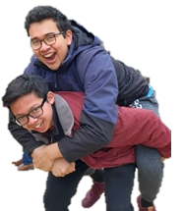

Slide 38
B2A2C3
6A8640
FFD360
262626

Slide 39

B2A2C3
6A8640
FFD360
262626

Slide 40
B2A2C3
6A8640
FFD360
262626

Slide 41
B2A2C3
6A8640
FFD360
262626

Slide 42
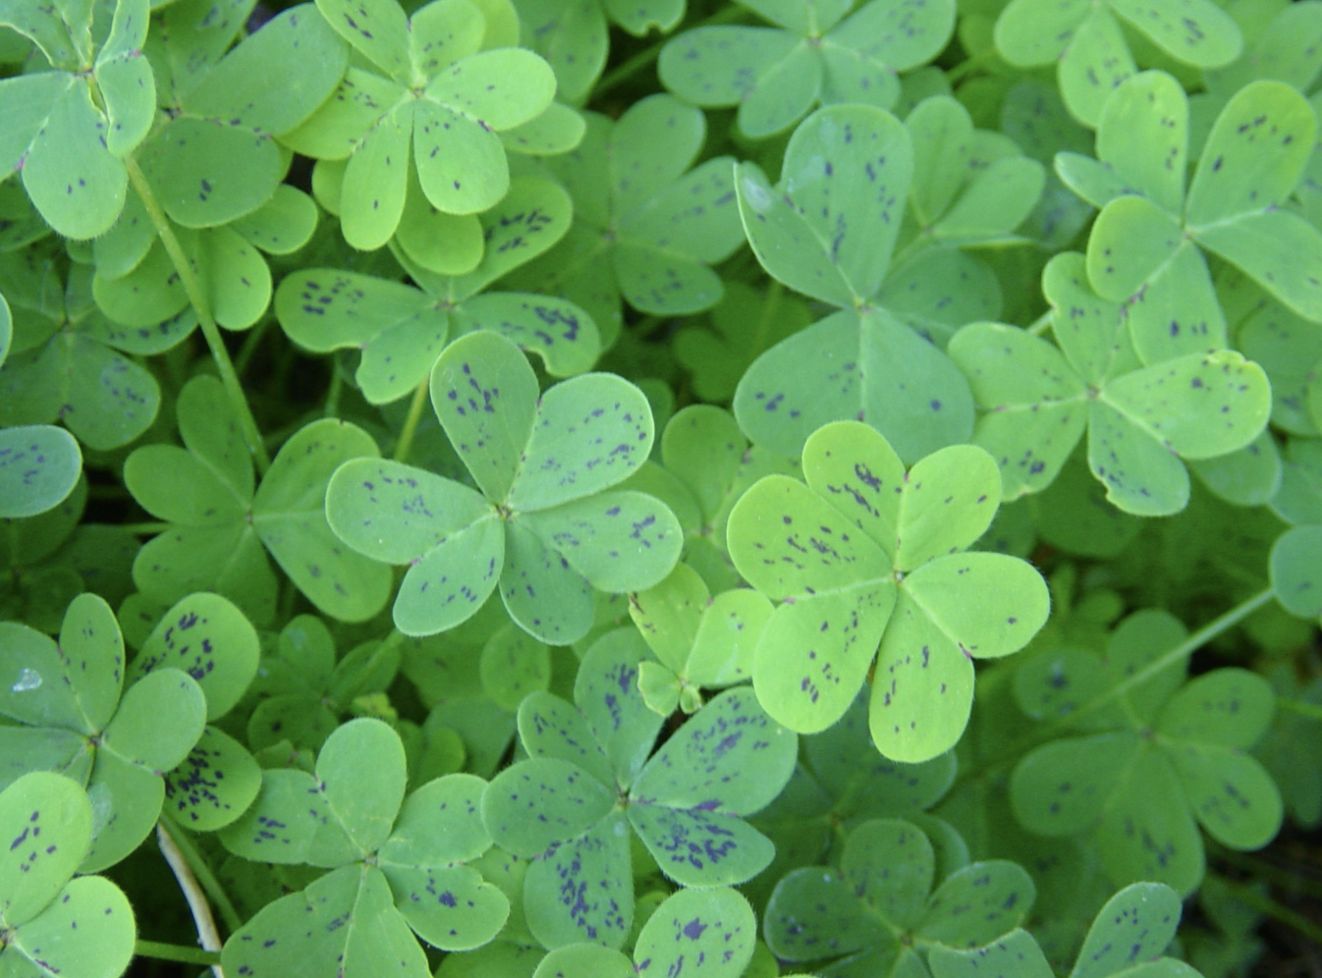
Abhiti

Slide 43
Abhiti

Slide 44

Abhiti

Slide 45
Abhiti
/ About
/ Resume
/ Projects
/ Contact

Slide 46
Abhiti
/ About
/ Resume
/ Projects
/ Contact

Slide 47
Abhiti
/ About
/ Resume
/ Projects
/ Contact

Slide 48
Abhiti
/ About
/ Resume
/ Projects
/ Contact

Slide 49
Abhiti
/ About
/ Resume
/ Projects
/ Contact

Slide 50
Abhiti
/ About
/ Resume
/ Projects
/ Contact

Slide 51
Abhiti
/ About
/ Resume
/ Projects
/ Contact

Slide 52
Abhiti
/ About
/ Resume
/ Projects
/ Contact

Slide 54


Slide 62
Abhiti Vaish
> About
> Resume
> Projects
> Contact
{ Passionate software developer, driven to interconnect our world with mobile & embedded solutions }

Slide 63
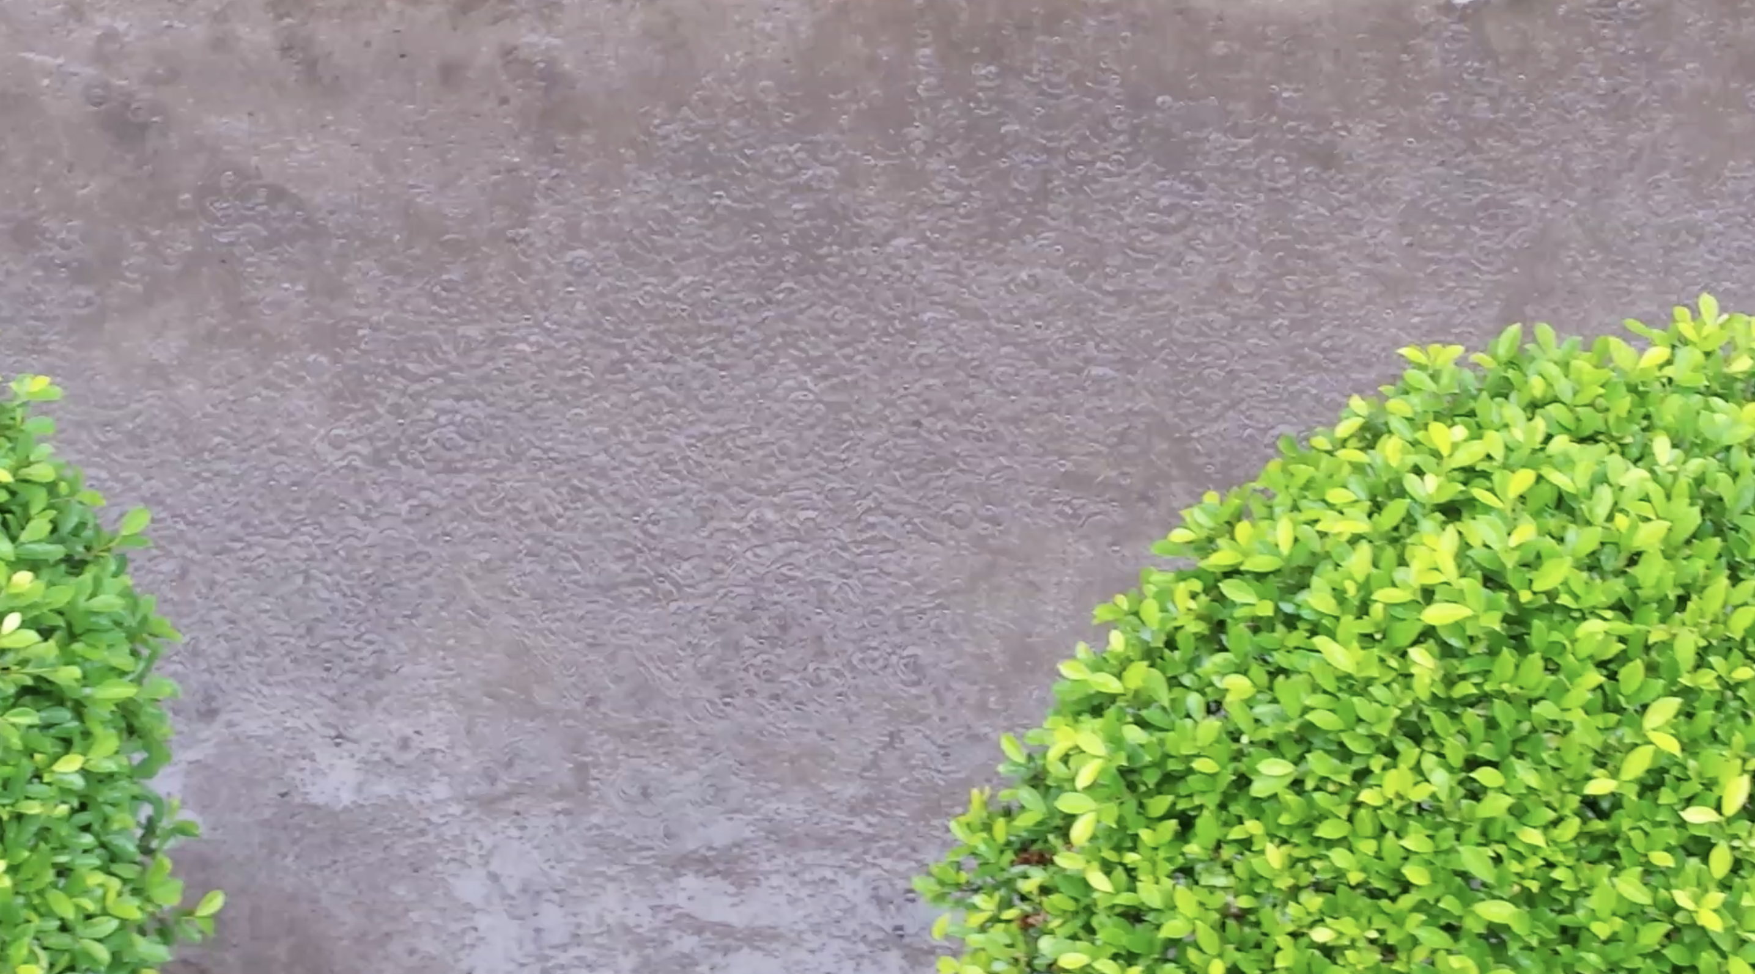
Abhiti Vaish
> About
> Resume
> Projects
> Contact
{Passionate software developer, driven to interconnect our world with mobile & embedded solutions}

Slide 64
Abhiti Vaish
About Resume Projects Contact
{Passionate software developer, driven to interconnect our world with mobile & embedded solutions}

Slide 65
Abhiti Vaish
About Resume Projects Contact
{Passionate software developer, driven to interconnect our world with mobile & embedded solutions}

Slide 66
Abhiti Vaish
About Resume Projects Contact
Passionate software developer, driven to interconnect our world with mobile & embedded solutions

Slide 67
Abhiti Vaish
About Resume Projects Contact
Passionate software developer, driven to interconnect our world with mobile & embedded solutions

Slide 68
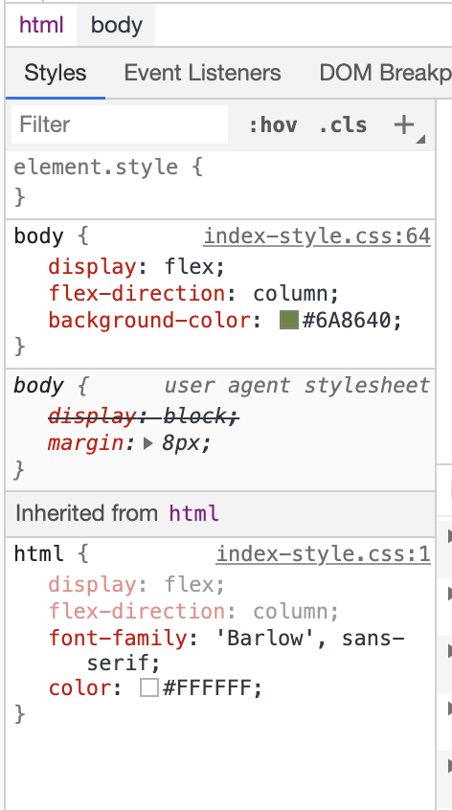
Abhiti Vaish
About Resume Projects Contact
Passionate software developer, driven to interconnect our world with mobile & embedded solutions

Slide 69
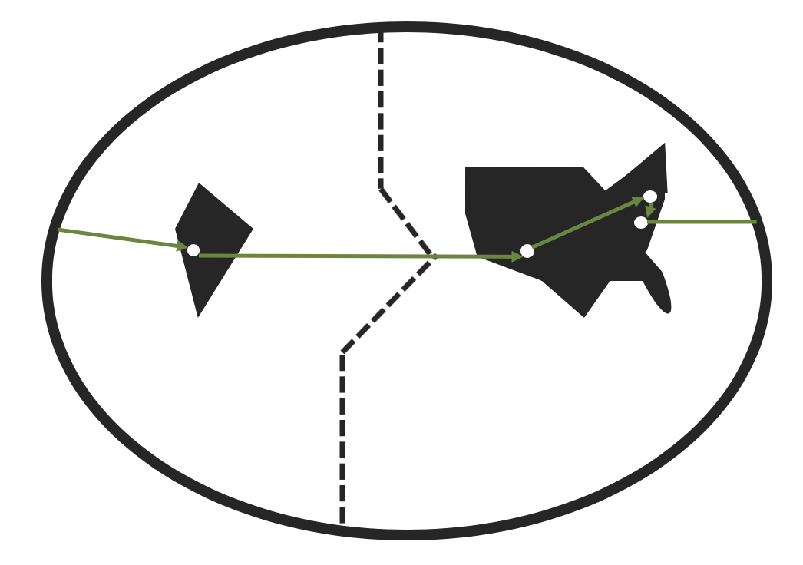
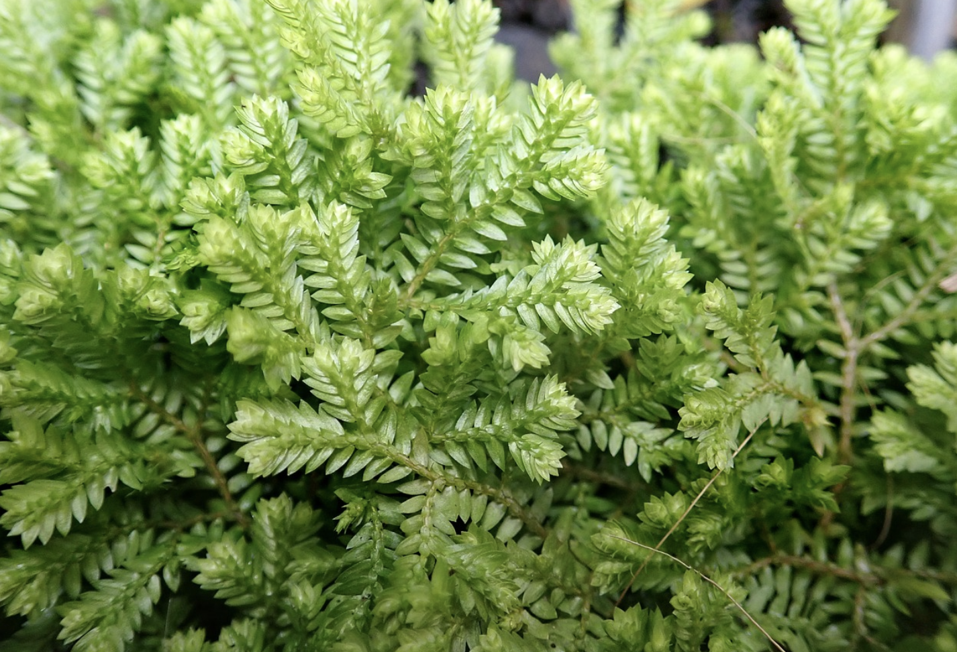
Abhiti Vaish
> About
> Resume
> Projects
> Contact
My name is Abhiti, and I'm a 22-year-old software developer. I am a graduate of the Massachusetts Institute of Technology '20. I majored in computer science, and minored in economics. I love to create mobile and IoT-based solutions to issues of international development. Over the course of these 2ish decades, I have lived in a handful of places around the world. I was born and raised in a suburb of New York. My family and I then relocated to the Indian financial capital, allowing my siblings and I to create our own memories in our motherland. Afterwards, I matriculated in the United World College in one of the most remote and picturesque areas of the US southwest, alongside peers from 70+ countries around the world. I, then, situated myself in America's biggest college town, and pretended to figure out how various algorithms work. I am currently waiting to begin my career as a Forward Deployed Engineer at Palantir Technologies, which will bring me all over the world!
1997 - 2007 Scarsdale, NY USA 2007 - 2014 Mumbai, MH India 2014 - 2016 Montezuma, NM USA 2016 - 2020 Cambridge, MA USA 2020 - 20?? New York, NY USA

Slide 70
Abhiti Vaish
About Resume Projects Contact
My name is Abhiti, and I'm a 22-year-old software developer. I am a graduate of the Massachusetts Institute of Technology '20. I majored in computer science, and minored in economics. I love to create mobile and IoT-based solutions to issues of international development. Over the course of these 2ish decades, I have lived in a handful of places around the world. I was born and raised in a suburb of New York. My family and I then relocated to the Indian financial capital, allowing my siblings and I to create our own memories in our motherland. Afterwards, I matriculated in the United World College in one of the most remote and picturesque areas of the US southwest, alongside peers from 70+ countries around the world. I, then, situated myself in America's biggest college town, and pretended to figure out how various algorithms work. I am currently waiting to begin my career as a Forward Deployed Engineer at Palantir Technologies, which will bring me all over the world!
1997 - 2007 Scarsdale, NY USA 2007 - 2014 Mumbai, MH India 2014 - 2016 Montezuma, NM USA 2016 - 2020 Cambridge, MA USA 2020 - 20?? New York, NY USA
Notes:
States are so diff, but pds so sim: standford prison expriment

Slide 71
Abhiti Vaish
{About} Resume Projects Contact
My name is Abhiti, and I'm a 22-year-old software developer. I am a graduate of the Massachusetts Institute of Technology '20. I majored in computer science and minored in economics. I love to create mobile and IoT-based solutions to issues of international development. Over the course of these 2ish decades, I have lived in a handful of places around the world. I was born and raised in a suburb of New York. My family and I then relocated to the Indian financial capital, allowing my siblings and I to create our own memories in our motherland. Afterwards, I matriculated in the United World College in one of the most remote and picturesque areas of the US southwest, alongside peers from 70+ countries around the world. I, then, situated myself in America's biggest college town, and pretended to figure out how various algorithms work. I am currently waiting to begin my career as a Forward Deployed Engineer at Palantir Technologies, which will hopefully bring me to the rest of the world that I have yet to explore!
1997 - 2007 Scarsdale, NY USA 2007 - 2014 Mumbai, MH India 2014 - 2016 Montezuma, NM USA 2016 - 2020 Cambridge, MA USA 2020 - 20?? New York, NY USA

Slide 72
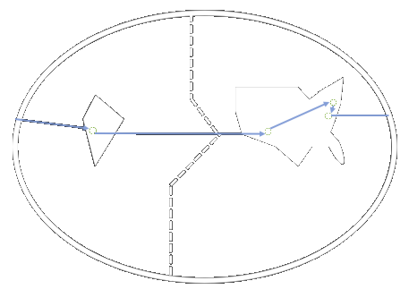
Abhiti Vaish
{About} Resume Projects Contact
My name is Abhiti, and I'm a 22-year-old software developer. I am a graduate of the Massachusetts Institute of Technology '20. I majored in computer science and minored in economics. I love to create mobile and IoT-based solutions to issues of international development. Over the course of these 2ish decades, I have lived in a handful of places around the world. I was born and raised in a suburb of New York. My family and I then relocated to the Indian financial capital, allowing my siblings and I to create our own memories in our motherland. Afterwards, I matriculated in the United World College in one of the most remote and picturesque areas of the US southwest, alongside peers from 70+ countries around the world. I, then, situated myself in America's biggest college town, and pretended to figure out how various algorithms work. I am currently waiting to begin my career as a Forward Deployed Engineer at Palantir Technologies, which will hopefully bring me to the rest of the world that I have yet to explore!
1997 - 2007 Scarsdale, NY USA 2007 - 2014 Mumbai, MH India 2014 - 2016 Montezuma, NM USA 2016 - 2020 Cambridge, MA USA 2020 - 20?? New York, NY USA

Slide 73
Abhiti Vaish
{About} Resume Projects Contact
My name is Abhiti, and I'm a 22-year-old software developer. I am a graduate of the Massachusetts Institute of Technology '20. I majored in computer science and minored in economics. I love to create mobile and IoT-based solutions to issues of international development. Over the course of these 2ish decades, I have lived in a handful of places around the world. I was born and raised in a suburb of New York. My family and I then relocated to the Indian financial capital, allowing my siblings and I to create our own memories in our motherland. Afterwards, I matriculated in the United World College in one of the most remote and picturesque areas of the US southwest, alongside peers from 70+ countries around the world. I, then, situated myself in America's biggest college town, and pretended to figure out how various algorithms work. I am currently waiting to begin my career as a Forward Deployed Engineer at Palantir Technologies, which will hopefully bring me to the rest of the world that I have yet to explore!
1997 - 2007 Scarsdale, NY USA 2007 - 2014 Mumbai, MH India 2014 - 2016 Montezuma, NM USA 2016 - 2020 Cambridge, MA USA 2020 - 20?? New York, NY USA

Slide 74
Abhiti Vaish
{About} Resume Projects Contact
My name is Abhiti, and I'm a 22-year-old software developer. I am a graduate of the Massachusetts Institute of Technology '20. I majored in computer science and minored in economics. I love to create mobile and IoT-based solutions to issues of international development. Over the course of these 2ish decades, I have lived in a handful of places around the world. I was born and raised in a suburb of New York. My family and I then relocated to the Indian financial capital, allowing my siblings and I to create our own memories in our motherland. Afterwards, I matriculated in the United World College in one of the most remote and picturesque areas of the US southwest, alongside peers from 70+ countries around the world. I, then, situated myself in America's biggest college town, and pretended to figure out how various algorithms work. I am currently waiting to begin my career as a Forward Deployed Engineer at Palantir Technologies, which will hopefully bring me to the rest of the world that I have yet to explore!
1997 - 2007 Scarsdale, NY USA 2007 - 2014 Mumbai, MH India 2014 - 2016 Montezuma, NM USA 2016 - 2020 Cambridge, MA USA 2020 - 20?? New York, NY USA

Slide 75
Abhiti Vaish
{About} Resume Projects Contact
My name is Abhiti, and I'm a 22-year-old software developer. I am a graduate of the Massachusetts Institute of Technology '20. I majored in computer science and minored in economics. I love to create mobile and IoT-based solutions to issues of international development. Over the course of these 2ish decades, I have lived in a handful of places around the world. I was born and raised in a suburb of New York. My family and I then relocated to the Indian financial capital, allowing my siblings and I to create our own memories in our motherland. Afterwards, I matriculated in the United World College in one of the most remote and picturesque areas of the US southwest, alongside peers from 70+ countries around the world. I, then, situated myself in America's biggest college town, and pretended to figure out how various algorithms work. I am currently waiting to begin my career as a Forward Deployed Engineer at Palantir Technologies, which will hopefully bring me to the rest of the world that I have yet to explore!
1997 - 2007 Scarsdale, NY USA 2007 - 2014 Mumbai, MH India 2014 - 2016 Montezuma, NM USA 2016 - 2020 Cambridge, MA USA 2020 - 20?? New York, NY USA

Slide 76
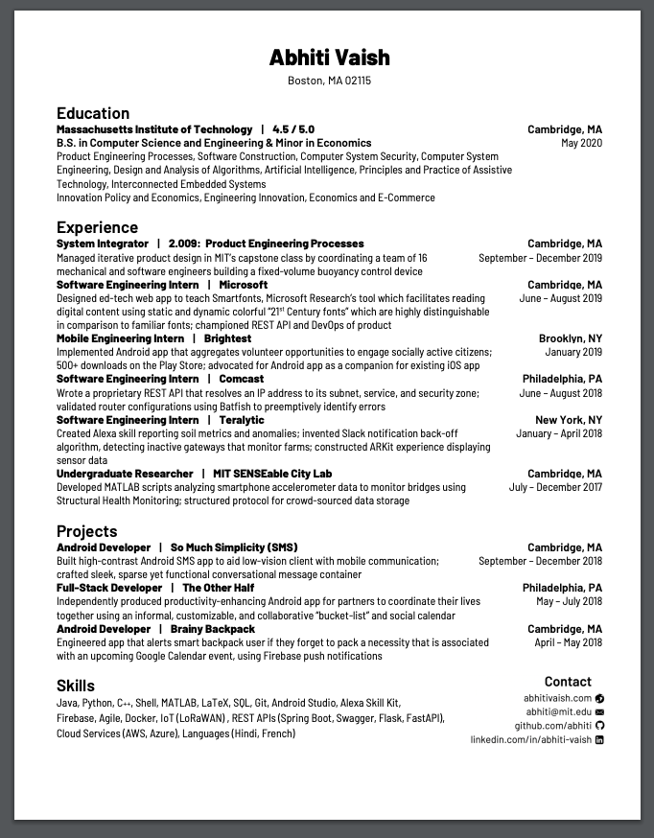
Abhiti Vaish
> About
> Resume
> Projects
> Contact

Slide 77
Abhiti Vaish
About Resume Projects Contact

Slide 78
Abhiti Vaish
About [Resume] Projects Contact

Slide 79
Abhiti Vaish
About [Resume] Projects Contact

Slide 80
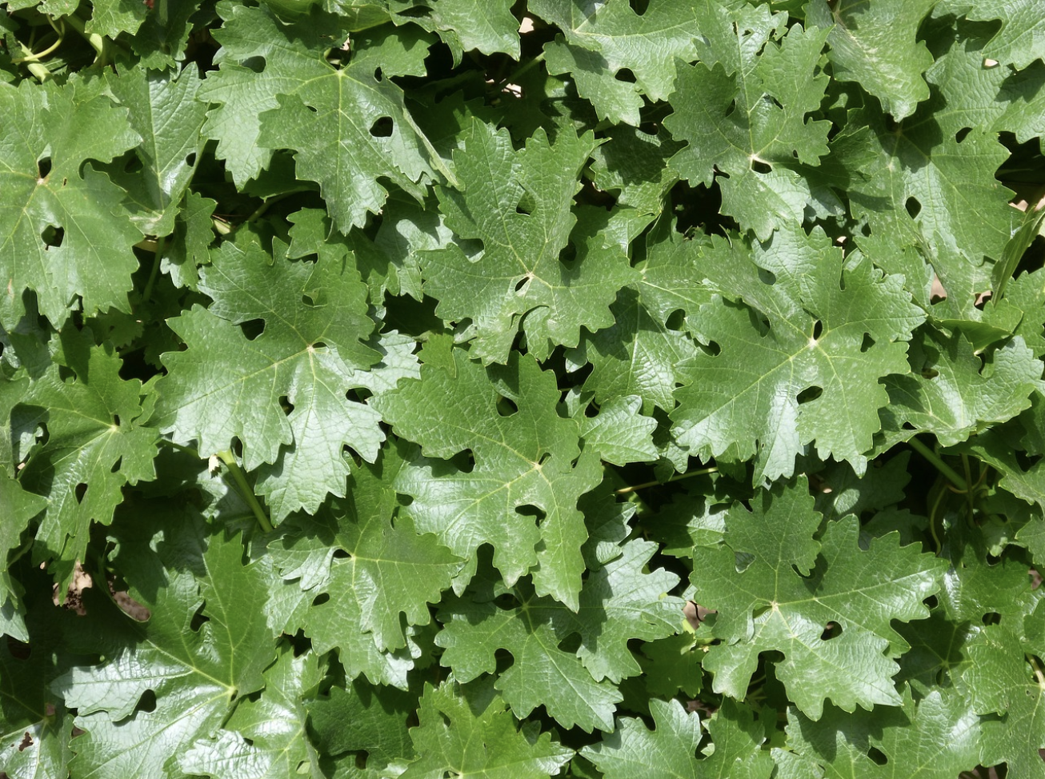
Abhiti Vaish
> About
> Resume
> Projects
> Contact
AUX
Rho
A democratic real-time song queuing device-agnostic platform
A fixed-volume buoyancy control device
So Much Simplicity
The Other Half
A high-contrast Android SMS app for low-vision users
A productivity tool for partners to plan their future events together
Brainy Backpack
Teralytic
A smart backpack that alerts you if you forgot an item you need imminently
An agtech Alexa skill based on Teralytic’s unique NPK sensors

Slide 81
Abhiti Vaish
About Resume Projects Contact
AUX
Rho
A democratic real-time song queuing device-agnostic platform
A fixed-volume buoyancy control device
So Much Simplicity
The Other Half
A high-contrast Android SMS app for low-vision users
A productivity tool for partners to plan their future events together
Brainy Backpack
Teralytic
A smart backpack that alerts you if you forgot an item you need imminently
An agtech Alexa skill based on Teralytic’s unique NPK sensors

Slide 82
Abhiti Vaish
About Resume Projects Contact
AUX
Rho
A democratic real-time song queuing device-agnostic platform
A fixed-volume buoyancy control device
So Much Simplicity
The Other Half
A high-contrast Android SMS app for low-vision users
A productivity tool for partners to plan their future events together
Brainy Backpack
Teralytic
A smart backpack that alerts you if you forgot an item you need imminently
An agtech Alexa skill based on Teralytic’s unique NPK sensors

Slide 83
Abhiti Vaish
About Resume <Projects> Contact
AUX
Rho
So Much Simplicity
A democratic real-time song queuing device-agnostic platform
A fixed-volume buoyancy control device
A high-contrast Android SMS app for low-vision users
The Other Half
Brainy Backpack
Teralytic
A productivity tool for partners to plan their future events together
A smart backpack that alerts you if you forgot an item you need imminently
An agtech Alexa skill based on Teralytic’s unique NPK sensors

Slide 84
Abhiti Vaish
About Resume <Projects> Contact
AUX
Rho
So Much Simplicity
The Other Half
Brainy Backpack
Teralytic

Slide 85
Abhiti Vaish
About Resume <Projects> Contact

Slide 86
Abhiti Vaish
About Resume <Projects> Contact

Slide 87
Abhiti Vaish
About Resume <Projects> Contact
X
AUX
A democratic real-time song queuing device-agnostic platform

Slide 88
Abhiti Vaish
About Resume <Projects> Contact
X
AUX
A democratic real-time song queuing device-agnostic platform

Slide 89

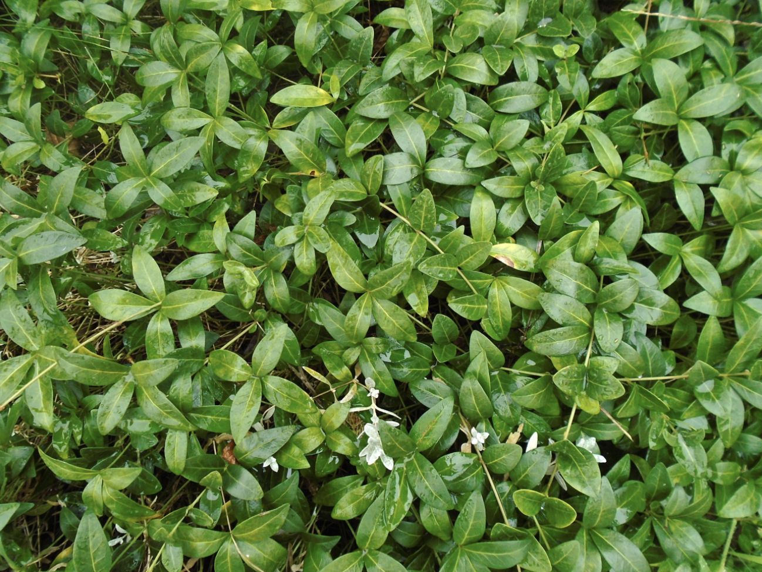





Abhiti Vaish
> About
> Resume
> Projects
> Contact
Email
GitHub
LinkedIn
Twitter

Slide 90
Abhiti Vaish
About Resume Projects Contact
Email
GitHub
LinkedIn
Twitter

Slide 91

Abhiti Vaish
About Resume Projects (Contact)
Email
LinkedIn
GitHub
Twitter

Slide 92
Abhiti Vaish
About Resume Projects (Contact)
Email
LinkedIn
GitHub
Twitter

Slide 93


Slide 94


Slide 95


Slide 98


Slide 99

AGV

